Slide 1
Technical Descriptive Writing

Slide 2
Length & Timing
You have to write at least 150 words. (maximum 200 words)
You are advised to spend 20 minutes on this task.

Slide 3
How to Describe a Graph in IELTS Writing Task? Follow the Seven Steps Process
Analyse the question
Identify the major features
Remember the 4 paragraph structure
Paraphrase the question sentence
Write an Overview paragraph
Write the Body paragraph 1
Write the Body paragraph 2

Slide 4
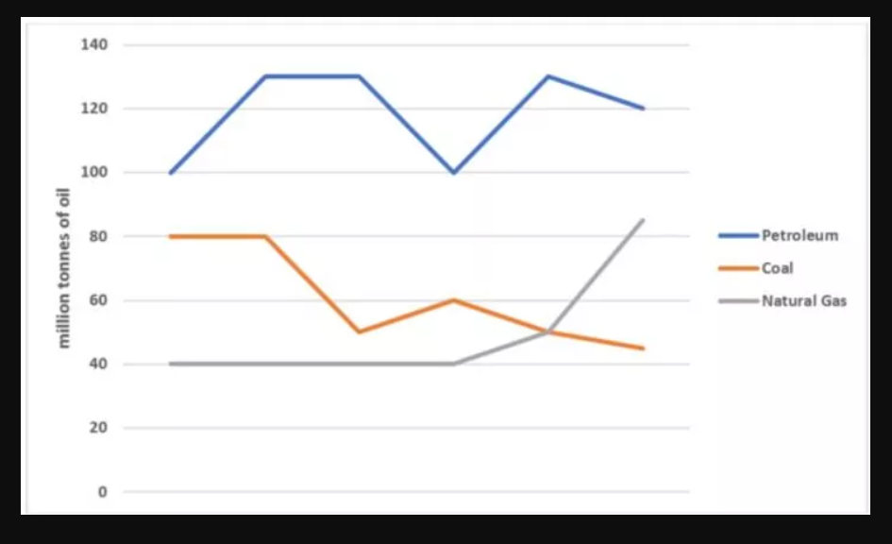
Question: You should spend about 20 minutes on this task. The graph below shows the production levels of main fuels in a European country from 1981 to 2000. Measured in tonnes. Write at least 150 words.

Slide 5
1. Analysing the Question
Find three major areas in the question sentence:
Topic Words / Keywords (General area of the question topic)
Micro Keywords (It helps us prepare a specific answer, rather than being general)
Action Words (The words that tell you what you need to do)

Slide 6
For the Example Provided:
Topic Words: production levels of main fuels
Micro Keywords: Petroleum, Coal, and Natural Gas; (1981 - 2000)
Action Words: Compare (Action words are the words that call for action. However, these words might not always be stated directly, in that case you need to understand what the examiner is expecting from you. For example, if there are more than one diagram or data set or graphical line as in this question, you can just go for comparing the major features).

Slide 7
2. Identifying the Major Features
Petroleum kept fluctuating, but always remained highest.
Coal declined gradually over the time.
Natural Gas experienced a sharp rise after a long stagnant period.
Only Natural Gas is rising at the end. The other two are falling.
Units are measured in tonnes.

Slide 8
3.Remembering the Essay Structure
Complete your essay in Four paragraphs
1. Paraphrasing the Question Sentence
Paraphrase the question statement using just one or two sentences.
2. Overview Paragraph
Sentence 1: summary statement 1(preview of the essay without presenting data)
Sentence 2: summary statement 2 (more preview without presenting data)
Sentence 3: outline sentence (State how the discussion will proceed.)
3. Body Paragraph 1
Sentence 1: first major point
Sentence 2: second major point
Sentence 3: extension sentence 1 (compare/combine the major points stated above)
Sentence 4: extension sentence 2 (extension of the previous sentence, or adding an exceptional feature).
4. Body Paragraph 2
Sentence 1: exceptional feature
Sentence 2: extension of the exceptional feature
Sentence 3: final sentence (wrapping-up the whole essay, completely based on the discussion above, nothing new)

Slide 9
4. Paraphrasing the Question Sentence
This paragraph is all about paraphrasing the question statement. That means you will restate the question sentence in your language without changing the meaning of the original sentence.
Original:
"The graph below shows the production levels of main fuels in a European country from 1981 to 2000. Measured in tonnes."
Paraphrased:
"The diagram illustrates the production levels of Petroleum, Coal and Natural Gas for a country over the period of 20 years, from 1981 to 2000. Units are measured in tonnes."
​

Slide 10
5. Overview Paragraph
An Overview simply means a summary of the main features that you are going to discuss in the body paragraphs. Don't use any data in this paragraph, just state the obvious feature that you see in the diagrams. You are writing this paragraph just to convey a general idea about your essay to the readers.

Slide 11
For the Example Provided:
Sentence 1(Summary Statement 1)
"Overall, instead of obvious fluctuation of production level, petroleum remained the highest level of fuel production in the whole period."
Sentence 2(Summary Statement 2)
"However, Coal went through a steady decline over the time. Whereas, Natural Gas started rising sharp after quite a long period of stagnant level of production."
Sentence 3(Outline Sentence)
"Significant features are discussed in the following paragraphs."

Slide 12
Complete Overview Paragraph
"Overall, instead of obvious fluctuation of production level, Petroleum remained the highest level of fuel production in the whole period. However, Coal went through a steady decline over the time. Whereas, Natural Gas started rising sharp after quite a long period of stagnant level of production. Significant features are discussed in the following paragraphs."

Slide 13
6. Body Paragraph 1
Sentence 1(First Major Point)
"Though its production went through ups and downs, Petroleum was always the largest level of fuel production comparing the other two."
Sentence 2(Second Major Point)
"Producing 80 million tonnes a year, Coal was the second major fuel production in 1981."
Sentence 3(Extension Sentence 1)
"Though the production level of Petroleum always kept fluctuating between 100 and 120 million tonnes, Coal experienced a steady decline over the period."
Sentence 4(Extension Sentence 2)
"Eventually in 2000, it ended up with producing the lowest level among the three major fuels."

Slide 14
Complete Body Paragraph 1
"Though its production went through ups and downs, Petroleum was always the largest level of fuel production comparing the other two. Producing 80 million tonnes a year, Coal was the second major fuel production in 1981. Though the production level of Petroleum always kept fluctuating between 100 and 120 million tonnes, Coal experienced a steady decline over the period. Eventually in 2000, it ended up with producing the lowest level among the three major fuels."

Slide 15
7. Body Paragraph 2
Sentence 1(Exceptional Feature)
"On the other hand, Natural Gas never experienced decline in this whole period, though it started 3rd in 1981 and passed a long stagnant production level."
Sentence 2(Extension of the Exceptional Feature)
"Bisecting Coal at 50 million tonnes, Natural Gas started increasing sharp and remained the only rising fuel at the end of the period."
Sentence 3(Final Sentence)
"Finally, instead of major fluctuations, Petroleum remained at the highest level of production, Coal experienced a steady decline and only Natural Gas was rising at the end of the period."

Slide 16
Complete Body Paragraph 2
"On the other hand, Natural Gas never experienced decline in this whole period, though it started 3rd in 1981 and passed a long stagnant production level. Bisecting Coal at 50 million tonnes, Natural Gas started increasing sharp and remained the only rising fuel at the end of the period. Finally, instead of major fluctuations, Petroleum remained at the highest level of production, Coal experienced a steady decline and only Natural Gas was rising at the end of the period."

Slide 17
Complete Version
The diagram illustrates the production levels of Petroleum, Coal and Natural Gas for a country over the period of 20 years, from 1981 to 2000. Units are measured in tonnes.
Overall, instead of obvious fluctuation of production level, Petroleum remained the highest level of fuel production in the whole period. However, Coal went through a steady decline over the time. Whereas, Natural Gas started rising sharp after quite a long period of stagnant level of production. Significant features are discussed in the following paragraphs.
Though its production went through ups and downs, Petroleum was always the largest level of fuel production comparing the other two. Producing 80 million tonnes a year, Coal was the second major fuel production in 1981. Though the production level of Petroleum always kept fluctuating between 100 and 120 million tonnes, Coal experienced a steady decline over the period. Eventually in 2000, it ended up with producing the lowest level among the three major fuels.
On the other hand, Natural Gas never experienced decline in this whole period, though it started 3rd in 1981 and passed a long stagnant production level. Bisecting Coal at 50 million tonnes, Natural Gas started increasing sharp and remained the only rising fuel at the end of the period. Finally, instead of major fluctuations, Petroleum remained at the highest level of production, Coal experienced a steady decline and only Natural Gas was rising at the end of the period.

Slide 18
Don’ts
Don’t write about everything on the graph.
Pick the biggest, the smallest, the main points, the main trends.
Group similar things together
Don’t write about the line or the bar: “The line went up,” “The bar went down.” Instead, write about the idea. “The number of people going to work by train increased gradually.” “Oil production shot up in 1965”
Don’t use “I feel”, “as I have written,” “as you can see,” etc. Keep it academic.
Don’t start sentences with But, So, Also, And, For, Since, Because, Although

Slide 19
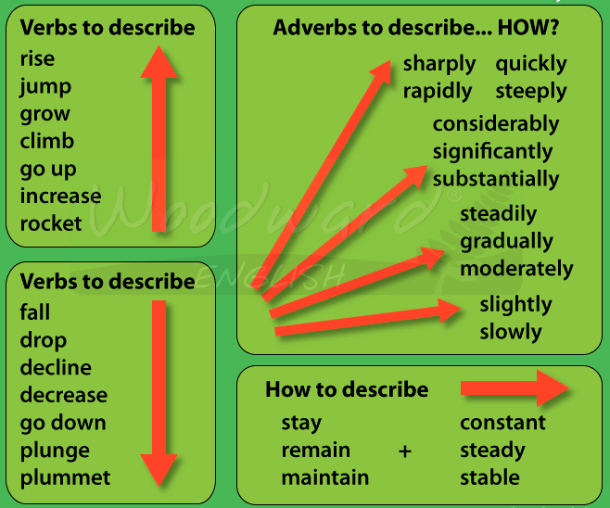
Describing Trends

Slide 20
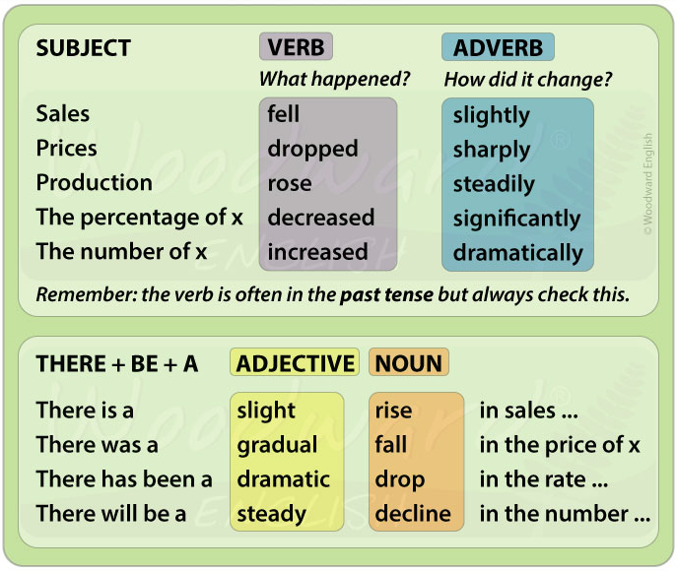
Word Order

Slide 21
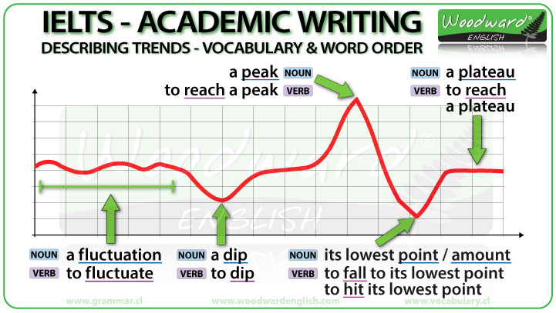
Describing Trends

Slide 22
Verb to show downward trend
decline | to become less, worse, or lower in value | Milk production could decline by 15% or more in the late summer months.
decrease | to become less, or to make something become less | The country’s total exports decreased by 6% in 2009.
collapse | to suddenly fall to a much lower level | prices/shares collapseShare prices collapsed after news of poor trading
fall | to become lower in size, amount, or strength | Salaries in the public sector are expected to fall by 15 percent this year.
plummet | to go down in amount or value very quickly and suddenly | plummet (by) sthFirst-half advertising revenues plummeted 13%, compared with the same period a year ago.
plunge | to go down in amount or value very quickly and suddenly | prices plunged $16.74, or 44%, to $20.51 a share.

Slide 23
Verb to show downward trend
slip | to become worse, lower, or less in value | February crude oil slipped 1¢ to $18.96 a barrel.
dip | to go down to a lower level, often by a small amount or for a short time | House prices are likely to dipin the first three months of the year.
slump | to fall suddenly in price, amount, or value | Home computer sales slumped dramatically last year.
tumble | to fall a lot in value in a short time | Share prices tumbled yesterday.
deplete | o reduce something in size or amount, especially supplies of energy, money, etc. | If we continue to deplete the earth’s natural resources, we will cause serious damage to the environment.
diminish | to reduce or be reduced in size, importance, or value | Over a period of several years, these securities diminished in value and the corporation went bankrupt.

Slide 24
Common Upward Trend Verbs
rocket | to rise extremely quickly | Stock prices rocketed to their highest level yesterday.
Surge | to increase suddenly and strongly | Shares surged to a record high.
Soar | to increase quickly in amount, number, value, or level | House prices soared a further 20 per cent.
leap | to increase, improve, or grow very quickly | Shares in the company leapt 250 per cent.
Boom | to increase or become successful and produce a lot of money very quickly | The housing market is booming.
Bounce | to suddenly increase, often after falling to its lowest level | The Group’s shares bounced 20%
Expand | to increase in size, number, or importance | Most noteworthy, we live in an expanding universe.
Escalate | to rise or to make something rise | As prices escalated, fewer people could afford a mortgage on a house.
Ascend | to move up or climb something | Finally, they slowly ascended the steep path up the mountain.

Slide 25
Common Upward Trend Nouns
Growth | an increase in size, amount, degree, level, etc. | The growth in the money supply was faster than expected.
Increase | a rise in the amount or size of something | There were 39,000 new cases last year – an increase of six percent.
rise | an increase | a 5 percent rise in inflation
Acceleration | an increase in the speed or rate of something | There has been a rapid acceleration in the rate of growth of new orders.
Development | the process in which someone or something grows or changes and becomes more advanced | Ever since was formed in 1968, the company has been at the forefront of computer development.
Expansion | the increase of something in size, number, or importance | the rapid expansion of the software industry
gain | an increase in something such as size, weight, or amount | After deducting costs, we still made a net gain of £5,000.
Ascent | the act of climbing or moving upwards | She made her first successful ascent of Everest last year.
Jump | a sudden increase | Interest rates are now at 6.75 – that’s a jump of almost 2 percent.

Slide 26
Adverbs
rapidly | very quickly; at a great rate | a rapidly growing economy
quickly | at a fast speed | The plane climbed quickly to a height of 30,000 feet.
swiftly | quickly; after a very short time | The sales increased swiftly.
suddenly | quickly and unexpectedly | The prices fell suddenly.
steadily | gradually and in an even and regular way | The company’s exports have been increasing steadily.
gradually | slowly over a period of time or a distance | The sales were declining gradually.
slowly | at a slow speed | The sales increased slowly.
sharply | in a way that is sudden and very noticeable | Dealer sales fell sharply in August.
moderately | to an average extent; fairly but not very | a moderately successful career/ She only
scarcely | only just; almost not | I was scarcely able to move my arm after the accident.
marginally | Slightly | marginally more expensive

Slide 27
Words and Phrases Describing Stability
Maintain | to make something continue in the same way or at the same level | We have been able to maintain prices for our customers at their current level.
Remain | to stay in the same place or in the same condition | Most commentators expect the basic rate of tax to remain at 25 percent.
level off | If a rate or amount levels off, it stops rising or falling and stays at the same level | House prices now seem to be levelling off after the steep rises of the last few years.
flatten out/ off | to stop rising or falling, and stay at the same level | A fall in house prices is unlikely; prices are more likely to flatten off.
Stagnate | to stay the same and not grow or develop | Their economy was stagnating, while Japan and Asia’s “tiger economies” were booming.
Stabilize | to cause something to become fixed and stop changing | In China, the policy of one child per family was introduced to stabilize the country’s population at 1.6 billion.
keep constant | to keep something the same | Unlike density-dependent limiting factors, density-independent limiting factors alone can’t keep a population at constant levels.

Slide 28
Verbs and Nouns Describing Fluctuation
fluctuate(fluctuate around) | to change, especially continuously and between one level or thing and another | Her wages fluctuate between £150 and £200 a week.
Vary | to change in amount or level or make a change in amount or level | vary between sth and sth Prices vary between $65 and $160.
fluctuation | a situation in which prices, levels or interest rates go up and down | Employers can adjust their workforce in line with fluctuations in demand for goods and services.
variation | a change in amount or level | The medical tests showed some variation in the baby’s heart rate.

Slide 29
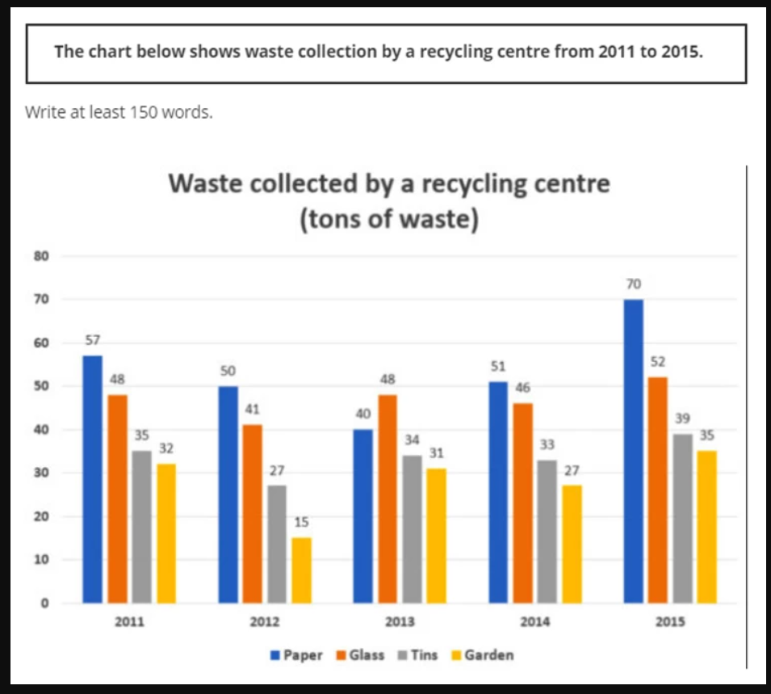

Slide 30
Sample answer
The diagram illustrates different categories of waste collected by a recycling centre over the period of five years in a row, from 2011 to 2015 inclusive. Unites are measured in tons.
Overall, throughout the whole period except 2013, paper was the leading amount of waste followed by glass, tins and gardens respectively. However, apart from 2015, total amount of waste from all the four categories was mostly stable over the period. Significant features are discussed in the following paragraphs.
Throughout the whole period, the proportional amount of waste collected from all the four categories remained same. Followed by Glass, Tins and Gardens respectively, Paper was almost always the leading amount of waste collected by the centre. However in 2013, Glass led the tally followed by Paper and Tins. Meanwhile, the level of Tins and Garden waste demonstrated neck and neck over the time, though the Garden waste always remained below.
However, the total amount of waste collection followed a different trend. In 2015, the centre collected total 196 tons of waste, which is the highest amount of total waste collected in one year, followed by 2011 and 2014. Finally, Paper was the leading amount of waste over the time, and 2015 was the highest amount of waste collected by the centre in a year.

Slide 31
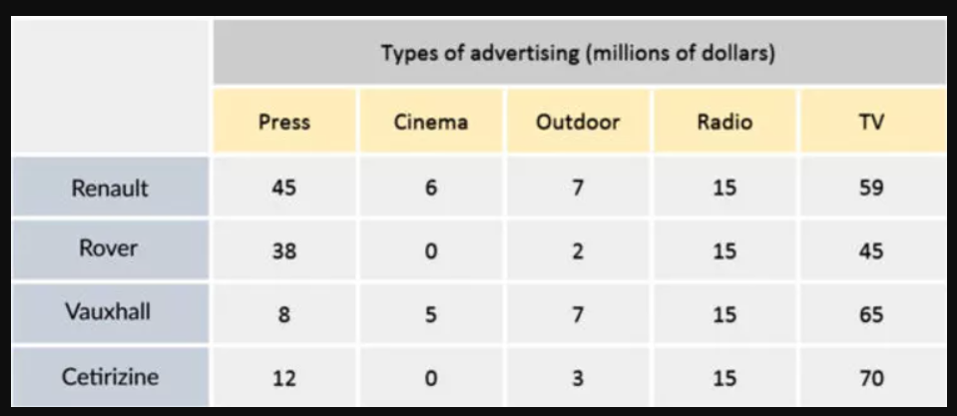
Table Chart

Slide 32
Sample Answer
The data table illustrates how many millions of dollars each of the four car companies spent for advertisement in the United Kingdom in 2002.
Overall, Renault was the leading spender on advertisement and TV attracted the highest expenses. Though the companies varied in their expenses on Press, Cinema and Outdoor advertisements, each of the them spent exactly the same amount of money on radio promotion. Major features are explained in the following paragraphs.
Renault led the promotional expense tally spending total 132 million dollars, whereas the other 3 companies spent equally 100 million dollars each. However, attracting total 239 million dollars, TV received the highest advertisement expenses from all the four companies. In terms of advertisement types and advertising companies, TV was followed by Press and Renault was followed by Vauxhall respectively. Meanwhile, all the four companies spent equally 15 million dollars each for radio promotion.
On the other hand, Cetirizine spent the highest 70 million dollars on TV promotions, followed by Vauxhall. However, Outdoor and Cinema always received the least amount of promotional expenses. Finally, TV grabbed the highest share of advertising expenditure from all the four companies, and Renault was the leading spender in advertisement purpose.

Slide 33
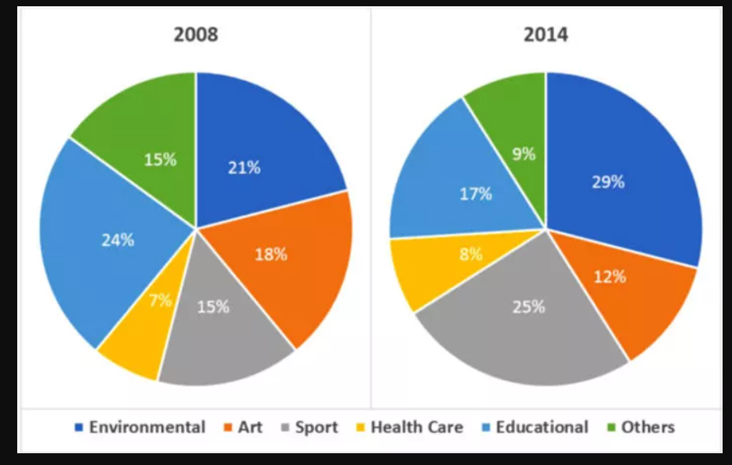

Slide 34
Sample Answer
The diagrams illustrate the rate of volunteer participation from different organisations for the periods 2008 and 2014.
Overall, out of the total 6 participating organizations, the percentage rate of volunteers from 3 organizations increased. Though Sport experienced the most significant change, Educational and Environmental organisations contributed the highest percentage of volunteers in 2008 and 2014 respectively. Major changes are explained below.
With 24% of total volunteer participation, Educational organization is the largest contributor of volunteers in 2008, followed by Environmental and Art. However in 2014, the highest 29% volunteers came from Environmental organisation. Educational organisation has gone through a moderate decline from 24% in 2008 to 17% in 2014, whereas Environmental organisation experienced an increase from 21% to 29% over the same period. Meanwhile, Health Care was the lowest contributor in both the periods.
On the other hand, only Sport's contribution increased significantly from 15% in 2008 to 25% in 2014, while all others went through a moderate rise or fall. Moreover, the rate of volunteer participation only from Health Care, Environmental and Sport increased, whereas all the other three declined over the same period. Finally, Educational and Environmental organisations were the highest contributors in 2008 and 2014 respectively, whereas Health Care remained the least contributor in both the periods.

Slide 35
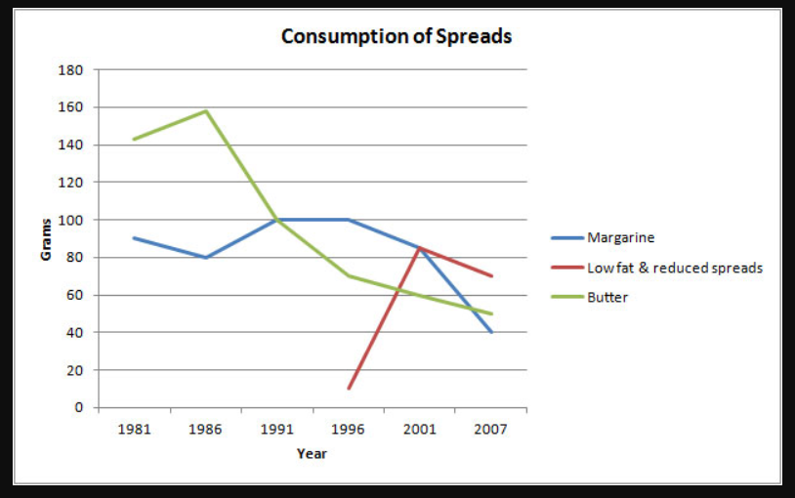

Slide 36
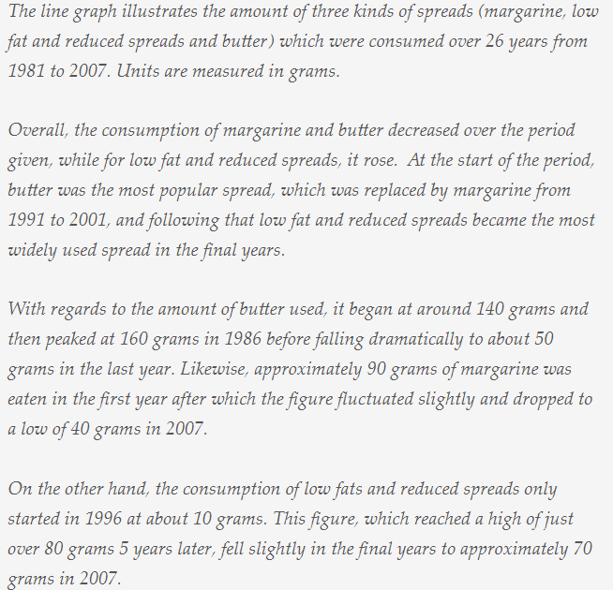

Slide 37
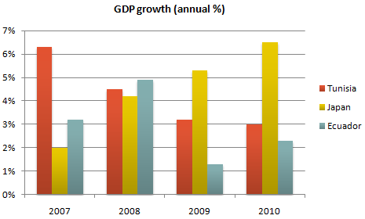
Bar Chart for Practice

Slide 38
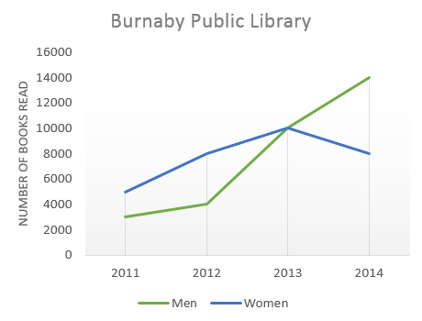
Line Graph for Practice

